Slide 1

TLDR: Text Summarization from basic to advanced approaches
Nattapat Juthaprachakul(njuthapr), Siyu Wu(swa246)
CMPT-825: Natural Language Processing
Simon Fraser University
Notes:
Too Long Don’t Read TLDR: Text summarization from basic to advanced approaches

Slide 2
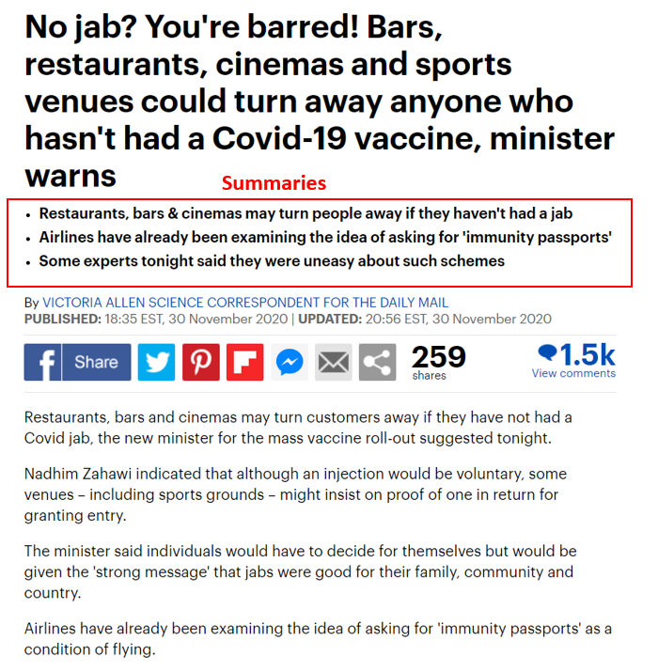
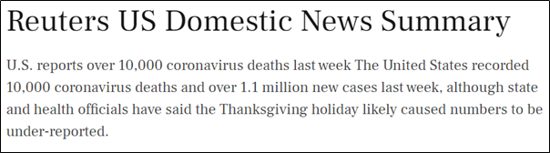
Text summarization
• Problem: what problem you are tackling and why it’s important
If you are doing something new, what are current approaches are and their limitations, and what is the insight of your approach that allows you to solve the problem better.
What is summarization?
Our goal
Notes:
So what is summarization? Text summarization is the task of producing a concise and fluent summary of texts or documents while preserving key information and overall meaning.
There are two main strategies for text summarization. The first is summarization by extraction, which consists of concatenating source sentences into a summary. And second is summarization by abstraction, which involves generating novel sentences for the summary
The goal of this project is to implement different Text summarization techniques on the same dataset and compare them based on the same evaluation metrics such as ROUGE.

Slide 3
Data: CNN/Daily Mail dataset of 305,758 samples
• Data/Task: Briefly explain (or better, give examples of) the data and/or task
• Clearly specify your input and output, give examples.
• Provide statistics (tables or charts) for your data
Split into train/validation/test sets with a ratio of 90/5/5
Stories: an average of 781 tokens.
Summaries: an average of 56 tokens.
Pre-processing: lower every letter and remove punctuation, number, tags, etc.
Use first 2 sentences of stories and 2 summaries
Story | The label on the package claimed that it contained T-shirts and baby toys. But when customs officials in Sydney X-ray scanned the parcel, they found instead five pythons and two venomous tarantulas. On Tuesday, authorities raided the house in Sydney to which the parcel had been addressed. Officials seized evidence but expect to file charges later, the customs agency said.(cont.)
Summary | -Customs officials in Australia find pythons and tarantulas in package -The parcel had been sent from the United States -The creatures were later killed because they posed a quarantine risk
Notes:
-We use raw data without data anonymization of the CNN-Daily Mail dataset, which consists of online news articles (or stories) paired with multiple summaries (or highlights). This data is shown in the table.
-The first feature is a text of news articles which is used as the documents to be summarized while the second feature is the joined text of highlights which is the target text summarization.
-The articles have an average of 781 tokens while the summaries have an average of 56 tokens.
- For pre-processing, we remove punctuation, number, and CNN and Daily Mail name tags at the beginning of every line. We also lower every letter in all words and remove noisy words that are not related to news articles such as advertisements.
-And to save computation time, we use only the first two sentence of stories together with 2 summaries.

Slide 4
Approach
Describe your main methods/techniques/models.
Diagrams are generally better than text, and equations should be used sparingly (if at all).
Highlight the core idea of your techniques.
Model | # Parameters | Pretrained data | Finetune data
LSTM | 28M | - | CNN/Dailymail
BART-base | 139M | XSum | CNN/Dailymail
BART-large | 406M | XSum | -
T5-small | 60M | C4 | -
T5-base | 220M | C4 | -
T5-large | 770M | C4 | -
Notes:
For our approaches,
-First, our baseline model is a vanilla LSTM sequence-to-sequence model which is a general Deep learning-based architecture used in NLP tasks. Generally, we use LSTM with an encoder-decoder architecture inspired by Neural Machine Translation and summaries are generated from the decoder, using target vocabulary. This model provides us a baseline of the training time and accuracy
-For our second model, we finetune the BART-base model on our pre-processed dataset. BART-base is a pre-trained transformer model trained on XSum news dataset. BART uses a standard sequence-to-sequence architecture with a bidirectional encoder similar to BERT and a left-to-right decoder similar to GPT.
-For BART-large, we directly use the model without finetuning.
-For T5, it is an encoder-decoder model pre-trained on a multi-task mixture of unsupervised and supervised tasks. It is trained on C4 dataset which is a cleaned version of Common Crawl’s web crawl corpus.
The goal of this model is to reframe all NLP tasks into a unified text-to-text-format where the input and output are always text strings. T5 uses the same Masked Language Model as BERT but it is different from BERT-based models that can only output either a class label or a span of the input. The advantage of this model is that it allows us to use the same model, loss function, and hyperparameters on any NLP task

Slide 5
Evaluation: Recall-Oriented Understudy for Gisting Evaluation
Describe your main methods/techniques/models.
Diagrams are generally better than text, and equations should be used sparingly (if at all).
Highlight the core idea of your techniques.
F1 of ROUGE-1, ROUGE-2, and ROUGE-L
F1 Score = 2*(Recall * Precision) / (Recall + Precision)
Precision = number of overlapping words / total words in system summary
Recall = number of overlapping words / total words in reference summary
Reference Summary | The cat was under the bed
System Summary | The cat was found under the bed
Precision | 6/7 = 0.86
Recall | 6/6 = 1
F1 or ROUGE-1 | 0.925
Notes:
-To evaluate the generated summaries, we use F1 from the ROUGE metric which is commonly used in summarization tasks.
-We select only three specific ROUGE metrics namely: ROUGE-1 and ROUGE-2 which are similar to the BLEU metric by measuring unigram and bigram similarity of reference summary and model-generated one. On the other hand, ROUGE-L measures the longest common subsequence between the two summaries.
-In this example, we can see that there are total 7 words in the system summary, and 6 of them are overlapping words,
so the precision score should be 6 divided by 7 and recall score is 6 divided by 6. And this two number will be used for calculating F1 score for ROUGE-1

Slide 6
Results
Present your most important results. Tables containing many numbers are overwhelming. Be selective and choose just the results that convey the story you’re telling. Make it clear what the evaluation metrics are, and what’s being compared
Model | ROUGE-1 | ROUGE-2 | ROUGE-L
LSTM | 0.12 | 0.02 | 0.11
BART-base | 0.22 | 0.08 | 0.20
BART-large | 0.27 | 0.13 | 0.25
T5-small | 0.27 | 0.13 | 0.26
T5-base | 0.28 | 0.13 | 0.27
T5-large | 0.28 | 0.13 | 0.26
Notes:
-Here is our result.
-From the table, we can see that vanilla LSTM model that was trained from scratch has a relatively disappointing performance in all ROUGE metrics compared with other models.
-The performance of Transformer-based models like BART-large model and all three T5 models almost doubles the LSTM model. Though, they have very similar performance to each other in all metrics regardless of size of models and underlying datasets.
-On the other hand, our finetuned Transformer-based BART-base model outperforms LSTM but still cannot compete with other Transformer models. This may be because of how we perform finetuning or data processing.
-Overall, the accuracy of the best model in our experiment is not high compared with the current state-of-the-art models.
-Nonetheless, in other experiments from different researchers using this same dataset, their best models hardly have an accuracy larger than 0.4.
-So, there is still a long way to go for text summarization.

Slide 7
Analysis
Show any plots, diagrams, examples and visualizations to provide interesting analysis. Make it clear what the reader should conclude from each figure.
Reference summary | -manchester united have made bastian schweinsteiger their top summer target. -louis van gaal eyes bastian schweinsteiger reunion at old trafford.
LSTM seq2seq | -manchester united have been linked with a move to manchester united.
BART-base | -manchester united have made bastian schweinsteiger their top summer target.
BART-large | -bastian schweinsteiger is thought to be keen on joining his former boss louis van gaal at old trafford.
T5-small | -manchester united have made bastian schweinsteiger their top summer target. -the schweinsteiger is thought to be keen.
T5-base | -manchester united have made bastian schweinsteiger their top summer target. -the schweinsteiger is thought to be keen.
T5-large | -manchester united have made bastian schweinsteiger their top summer target. -schweinsteiger is thought to be keen on.
Notes:
-Here are the examples of our model outputs compared with a reference summary.
-We can see that the summary output from LSTM sequence to sequence model is incorrect as seen in the word like Manchester United repeating itself in both subject and object.
-In contrast, the outputs of other models are correct and understandable in terms of meaning and grammar.
-There are two key points in the reference summary.
- The first is Manchester united have made Schweinsteiger as their top target. BART base model and all T5 models identified this point successfully.
-The other point is Van Gall eyes Scheweinsteiger reunion at Old Trafford. And for this point, only BART large model can capture this detail.
-To summarize, almost all the models successfully summarize one key point from the text except the LSTM model.
-And the sentences they generate are readable and concise.
-Although none of them point out both of two key points, we think that their performance are acceptable and helpful.

Slide 8
Conclusion and Future work
Transformer is better than Sequence-to-sequence model
Our models can generate a correct and readable summary in some cases.
Text summarization is still a challenging topic.
Future work: incorporate Named-entity recognition
Notes:
From our analysis of news summarization, we conclude that
The accuracy of text summarization models can be increased by using transformers.
Our current models can generate a correct and readable summary sentence in some cases.
Text summarization is still a challenging topic.
The overall accuracy of our models is still relatively low; and in other experiments, researchers can hardly generate a model with the accuracy higher than 0.4.
For Future work, we can incorporate Named-entity recognition to our model since large portion of summaries involve named entity

Slide 9
References
[1] Sutskever, I., Vinyals, O., and Le, Q.V. (2014). Sequence to Sequence Learning with Neural networks. In Advances in Neural Information Processing (NIPS), Montreal, Canada.
[2] Mike Lewis, Yinhan Liu, Naman Goyal, Marjan Ghazvininejad, Abdelrahman Mohamed, Omer Levy, Ves Stoyanov, & Luke Zettlemoyer. (2019). BART: Denoising Sequence-to-Sequence Pre-training for Natural Language Generation, Translation, and Comprehension.
[3] Colin Raffel and Noam Shazeer and Adam Roberts and Katherine Lee and Sharan Narang and Michael Matena and Yanqi Zhou and Wei Li and Peter J. Liu (2019). Exploring the Limits of Transfer Learning with a Unified Text-to-Text TransformerCoRR, abs/1910.10683.

Slide 10
[4] Lin, C.Y. (2004). ROUGE: A Package for Automatic Evaluation of Summaries. In Text Summarization Branches Out (pp. 74–81). Association for Computational Linguistics.
[5] R. N. et al., “Cnn/dailymail dataset,” CoNLL, 2016
[6] Thomas Wolf and Lysandre Debut and Victor Sanh and Julien Chaumond and Clement Delangue and Anthony Moi and Pierric Cistac and Tim Rault and Rémi Louf and Morgan Funtowicz and Jamie Brew (2019). HuggingFace's Transformers: State-of-the-art Natural Language ProcessingCoRR, abs/1910.03771.
[7] X. Carreras, L. Màrquez, Introduction to the CoNLL-2004 shared task: Semantic role label-ing, in Proceedings of the Eighth Conference on Computational Natural Language Learning (CoNLL-2004) at HLT-NAACL 2004(2004), pp. 89–97

